Slide 1
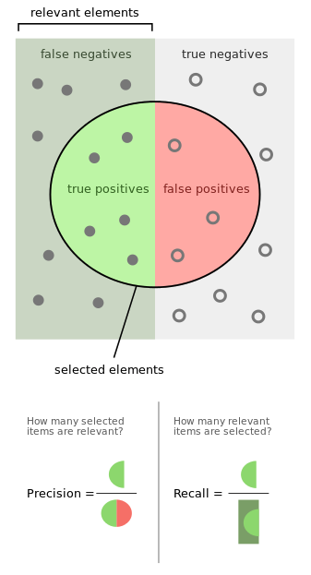
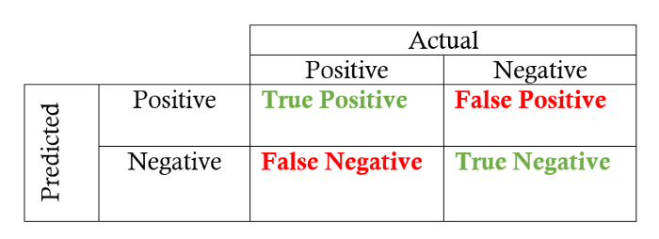
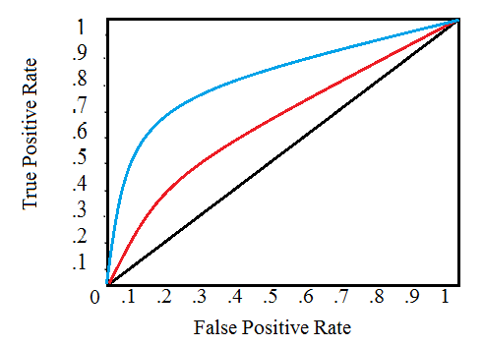

Slide 2

it is technically a measure of accuracy, but instead of taking the total number of true positives and dividing by the total number of samples, it performs this convoluted calculation above
why not just use accuracy?
because oftentimes you’ll find your data isnt balanced, if you had a 50/50 split of diabetes and non-diabetes, the simple way of calculating it would be appropriate

Slide 3
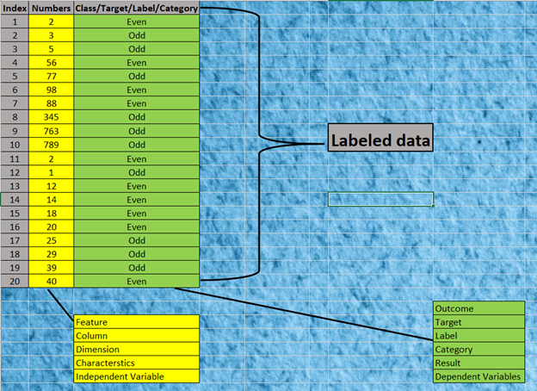
Precision/Recall Tradeoff
Let’s understand the Precision and Recall before understanding the concept precision/recall tradeoff. To understand the precision and recall, let’s understand the Confusion Matrix first.
Confusion Matrix
This is the most important performance measure tools for Classification in machine learning. As we know, Classification is one of the supervised tasks in machine learning, where you provide the labeled data to the model or algorithm (Labeled data — Where you have the output or target or class against the features or input, ex shown in below table).

Slide 4

Beyond Accuracy: Precision and Recall

Slide 5
0% indicates that the model explains none of the variability of the response data around its mean.
100% indicates that the model explains all the variability of the response data around its mean. In general, the higher the R-squared, the better the model fits your data (doesn't always mean its a good thing)

Slide 6
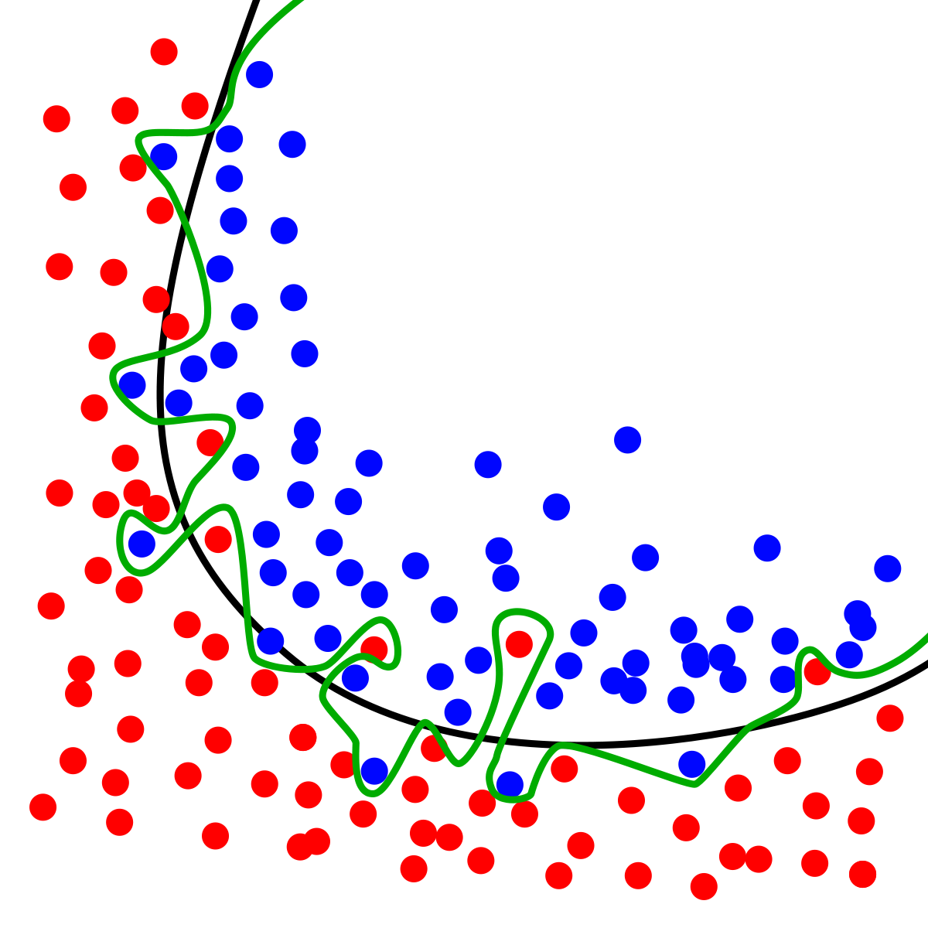
the green line is going to have a r2 close to 1
but it isnt going to be a great model, even though it explains the red dots (the variance) very well
Having a square as opposed to the absolute value function gives a nice continuous and differentiable function (absolute value is not differentiable at 0) - which makes it the natural choice, especially in the context of estimation and regression analysis.

Slide 7
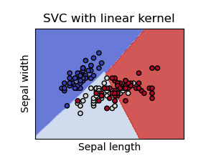
hyperplane decision boundaries represented in 2D

